Slide 1
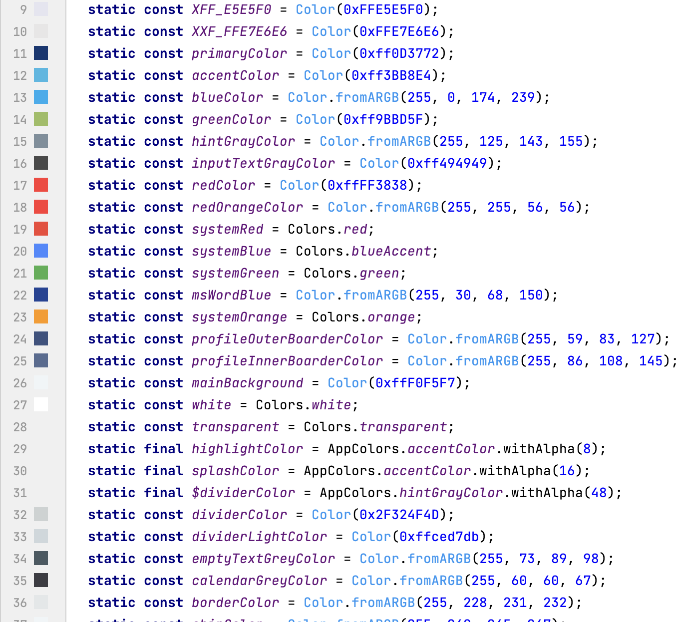
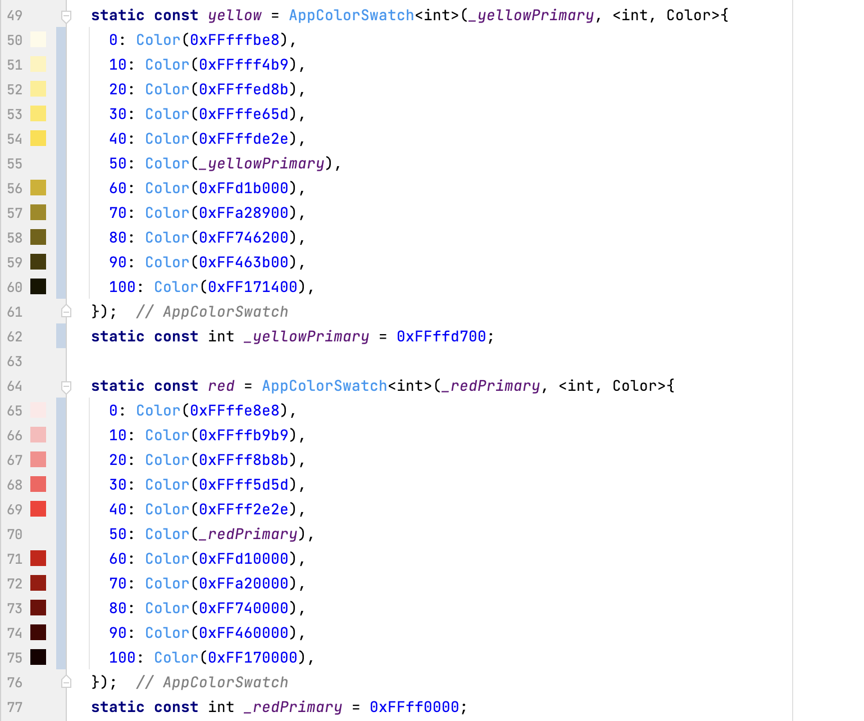
1. Migrate to color swatch.
Current Colors
Colors Swatch

Slide 2
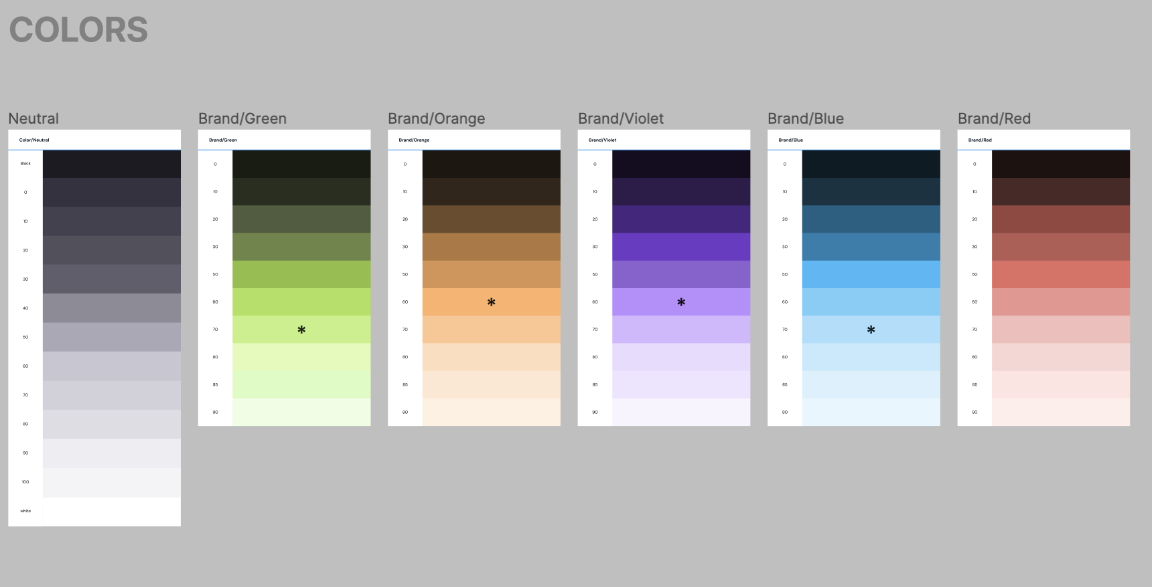
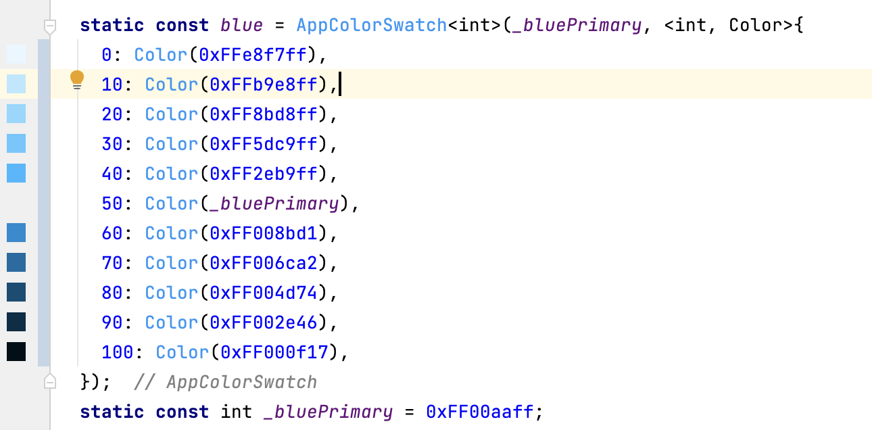
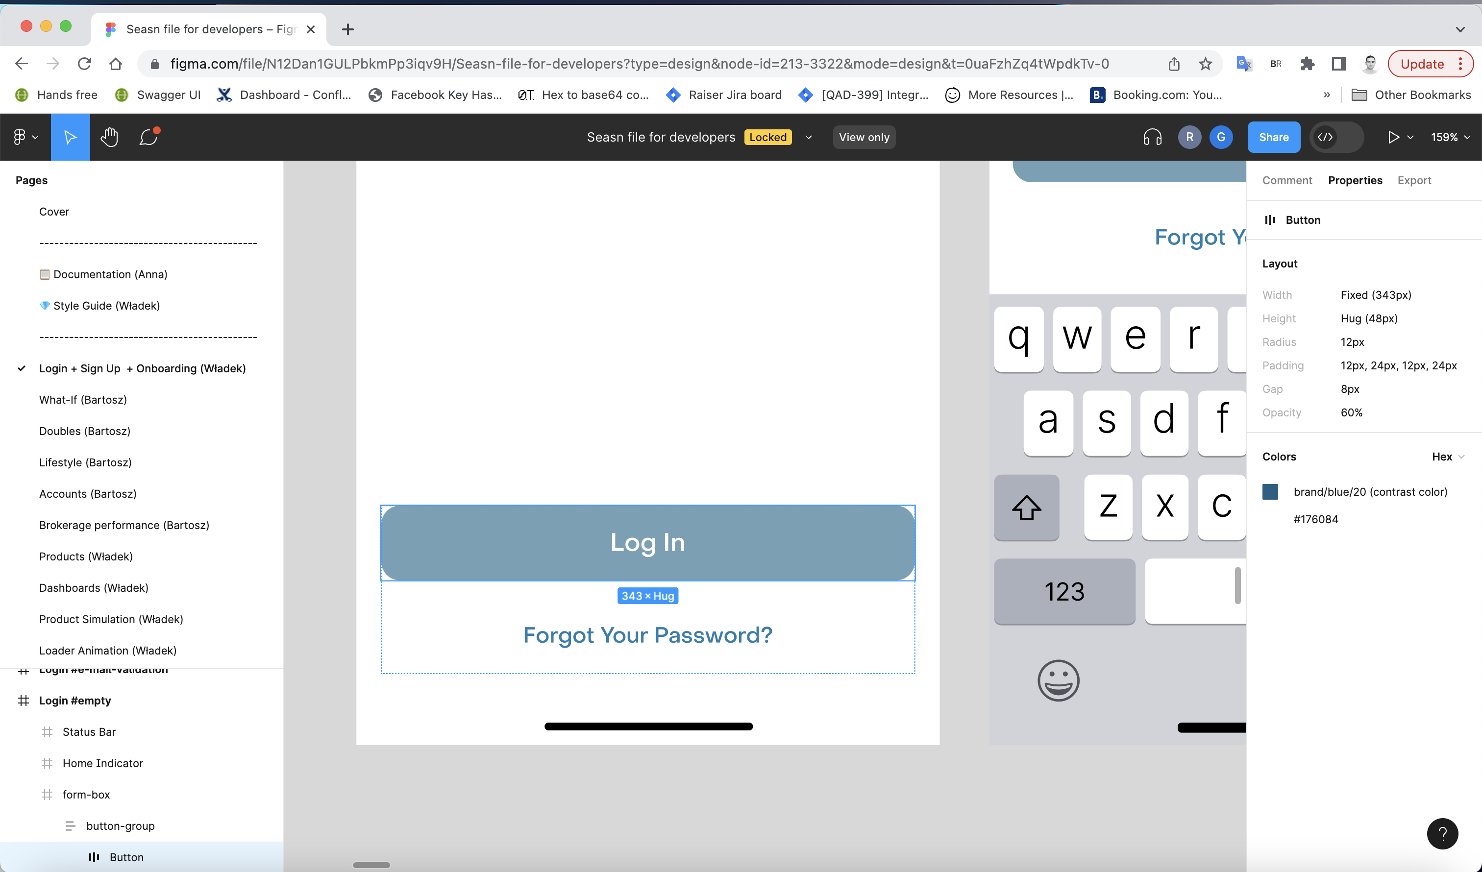
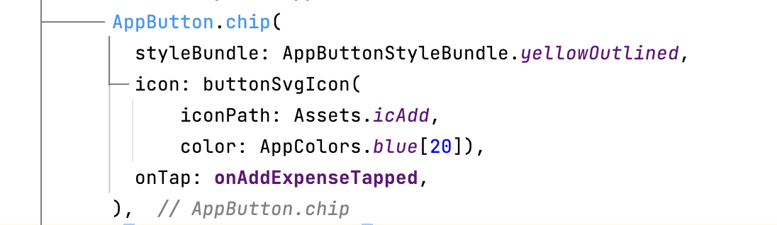
1. Migrate to color swatch.
Figma style guide
Color Swatch
Figma design
Usage

Slide 3
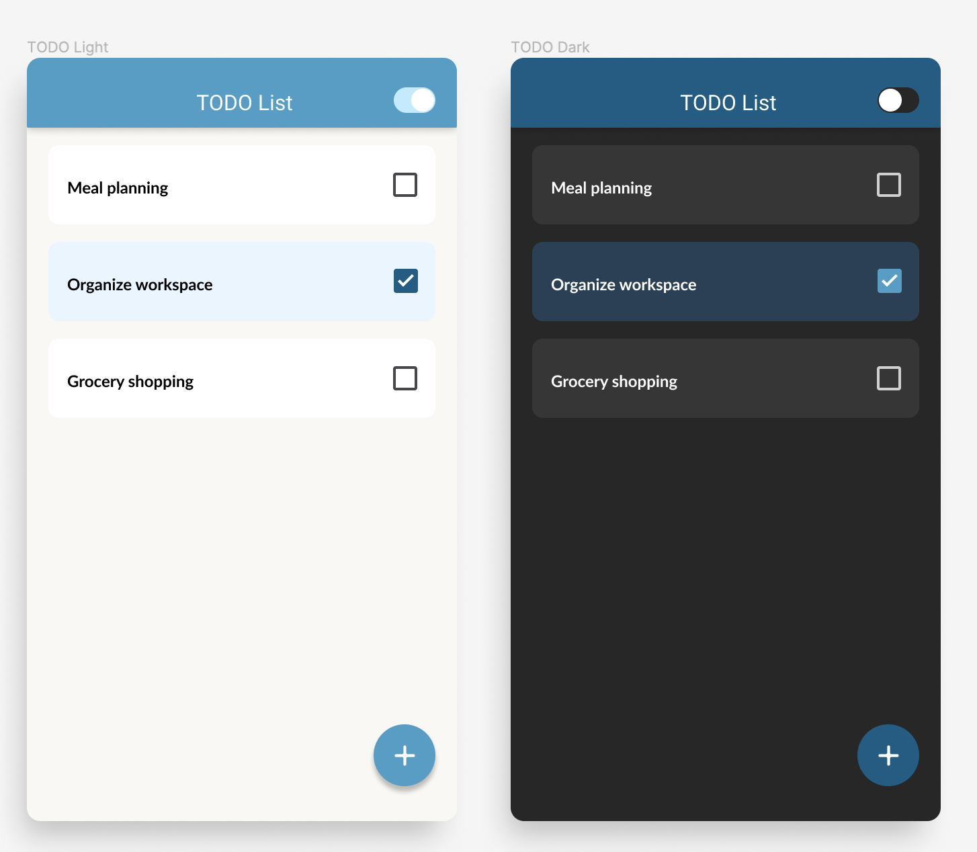

Steps to create dark mode.
1. Migrate to color swatch.
2. Define ThemeData and set all styles with the ThemeData.
3. Create ThemeExtentions for custom styles.
4. Define Dark theme data.
Figma Designs

